Slide 1
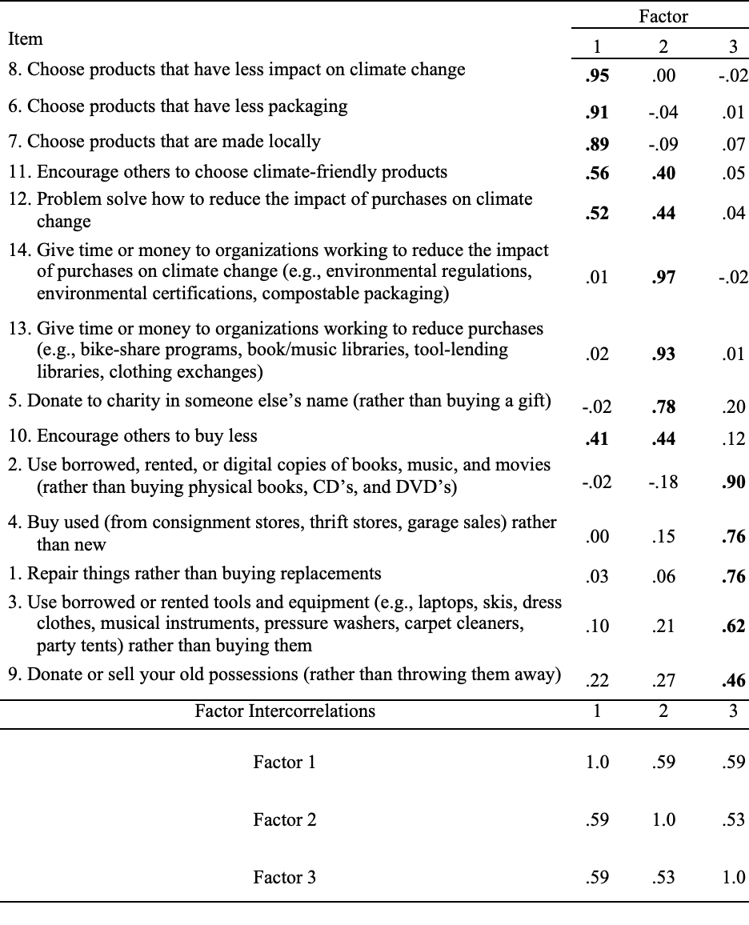
An Exploratory Factor Analysis of Climate Friendly Purchasing Choices
Susan E. Gutierrez, Fred Vincent Y. Margallo, Zihan Gong, Yuhan Bi, & Kimberly A. Barchard
University of Nevada, Las Vegas
Climate change is the long-term shifts in temperature and weather patterns across the Earth, which can cause significant damage to the planet and its inhabitants.
People’s increased awareness of the issues surrounding climate change have made many willing to adopt climate friendly purchasing choices. Nekmahmud and Fekete-Farkas (2020) found that consumers' environmental concerns, green perceived benefits, green awareness of price, green willingness to purchase, and future estimation of green marketing had a strong positive influence on consumers' green purchase decisions.
The Climate Change Action Inventory (CCAI; Barchard et al., 2022) measures how often individuals take actions that can reduce climate change. Our study focused on the Climate Friendly Purchasing Choices Domain, which measures how often individuals take actions like choosing products with less packaging and reusing items rather than buying new.
We conducted an exploratory factor analysis of the Climate Friendly Purchasing Choices Domain to helped us examine the factor structure of the domain and to further develop the scale for future researchers.
500 Mturk workers were recruited as research participants from among CloudResearch’s Approved Participants. After filtering out 15 climate change deniers and 24 multivariate outliers, 461 participants remained, between the ages of 19 and 76 (M = 39.61, SD = 11.86).
The Climate Friendly Purchasing Choices Domain measures how often participant’s take climate change actions using 14 items on a nine-point frequency scale with response options ranging from 1 (less than once a year) to 9 (at least 14 times a week).
All participants completed the Climate Change Action Inventory and demographic questions online.
We determined the number of factors based upon the scree test, parallel analysis, and minimum average partial test.
We tried six rotations (both orthogonal and oblique) and selected the one that came closest to the ideal of simple structure using the criteria of number of complex items, hyperplanar count, and correlation among the factors. We selected the three-factor solution with a direct oblimin rotation.
There are three factors that underlie the Climate Friendly Purchasing Choices Domain from the CCAI (see Table 1).
We labeled these factors as Purchasing Eco-Friendly Products, Indirectly Reducing Purchasing Impacts, and Utilizing Secondhand Items
The maximum absolute correlations between the factors was .59 and the average absolute correlation was .57.
One limitation of our study was the lack of generalizability to other populations.
Most (384 of 461) participants identified as Caucasian/White.
All participants were from the United States.
The results may be less representative of other groups as different ethnicities and cultures have different views on climate-friendly purchasing choices.
The three factors had moderate to high intercorrelations, demonstrating that these three areas are highly related.
Attempts to reduce climate change by altering purchasing habits could target any one of these three areas.
Future research could explore which factors best predict these three types of climate-friendly purchasing choices.
Results
Introduction
Three factors underlie climate-friendly purchasing choices.
Discussion
Table 1
Factor Analysis of the Climate-Friendly Purchasing Choices Domain
Method
Note. Salient factor pattern matrix coefficients are in boldface. No items were reverse-scored for this analysis. Factor 1 = Purchasing Eco-Friendly Products. Factor 2 = Indirectly Reducing Purchasing Impacts. Factor 3 = Utilizing Secondhand Items.

