Slide 1
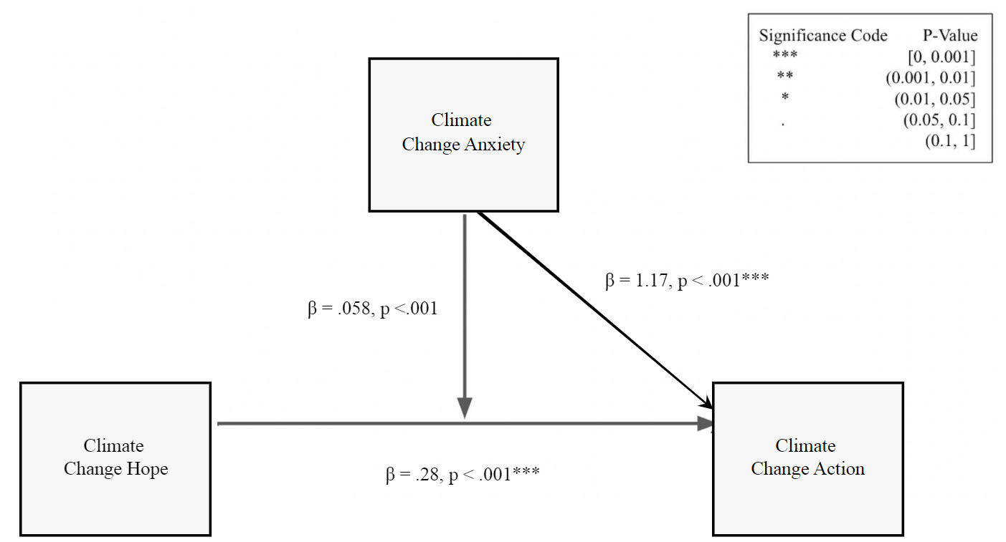
Understanding the Relationship Between Climate Change Anxiety, Hope, and Action: A Moderation Analysis
Jin Qian, Daniela Alvarez, Ishrat Zaman, Yuhan Bi, & Kimberly A. Barchard
University of Nevada, Las Vegas
Introduction
Climate change affects all species on Earth, and immediate action is required to mitigate these negative effects.
Climate change anxiety: the presence of constant worry, future-oriented apprehension, and functional impairments due to climate change.
Climate change action: any action that can potentially reduce climate change.
Climate change hope: one’s belief in their ability to ameliorate the negative effects of climate change.
Moderator: a third variable that affects the strength or the direction of the relationship between two other variables by interacting with them.
Purpose of this study: to explore whether climate change anxiety moderates the relationship between hope and action.
Method
All 500 participants were recruited from Amazon’s Mechanical Turk (MTurk) in the United States. To increase the quality of our data, these participants were recruited from among CloudResearch’s Approved Participants.
15 climate change deniers were filtered out, because we are interested in reactions to beliefs in climate change.
11 mMultivariate outliers were filtered out so that these participants did not have an undue effect on the results.
After the data filtering, we were left with 474 participants
197 female, 275 male, and 2 non-binary.
Age ranged between 19 and 79 years old (M = 39.72, SD = 11.86)
392 participants identified as Caucasian/White, 40 as African American/Black, 25 as Asian, 4 as Native American, 1 as Native Hawaiian/Other Pacific Islander, and 2 as other.
Three questionnaires are involved in the current research:
Climate Change Hope Scale (CCHS): 11-item questionnaire developed to measure hopefulness in the face of climate change.
Climate Change Anxiety Scale (CCAS): 13-item questionnaire measuring cognitive-emotional and functional impairment due to climate change.
Climate Change Action Inventory (CCAI): 77 items divided into eight domains, measuring how often individuals take actions that can reduce climate change.
The scores of the scales were zero-centered and we created a linear regression model in R to test for the significances of climate change anxiety, climate change hope, and the interaction term between climate change hope and anxiety.
\
Note: Significant codes are a series of stars or a decimal point if the variables are statistically significant. Asterisk is used to indicate the significance of P- value.
Results
Climate change hope (β = .28, t(470) = 7.28 , p < .001) and anxiety (β = 1.17, t(470) = 17.92, p < .001) each predicted action, but they did not interact (β = .06, t(470) = .82 , p = .415).
This indicates that anxiety does not moderate the relationship between climate change hope and action. On the other hand, hope has a small effect on action and anxiety has a large effect.
Discussion
Implications
People who are more hopeful take more action: They know they can make a difference.
People who are more anxious take more action: They know urgent action is needed.
Perhaps increasing hope and anxiety increase climate change action.
Limitations
Correlational design does not allow causal claims.
Lack of racial diversity among participants.
Lack of adolescent participants.
Future Research
Future research can use randomized controlled experiments to determine if hope and anxiety cause action.
Future research can investigate the relationship between climate change hope, anxiety, and action in younger people and in people from other countries or ethnic groups.
They can also conduct research that examines the role of hope and anxiety in climate change action in specific contexts, such as vulnerable communities, policymakers, and climate change activists.
Figure 1
Investigating Whether Climate Change Anxiety Moderates the Relationship Between ClimateChange Hope and Action
Climate change hope and anxiety predict climate change action

